Slide 1

P peline
The Data
Byte 4
© Jennifer Mankoff
The Data Pipeline; HCII; Spring 2014

Slide 2
Mobile Data
Increasingly prevalent; increasingly rich
Great source of context
(information that can be used [acted on, displayed]
to characterize the setting in which the user is
operating)
Common uses of context
location aware services
adaption to changes in environment
retro-active understanding of users

Slide 3
Sensors
Accelerometer
Applications
Battery
Bluetooth
Calls
Messaging
Gravity
Gyroscope
Light
Linear Accelerometer
Location
Magnetometer
Network Usage
Orientation
Pressure
Processor
Proximity
Rotation
Screen
Telephony
Temperature
Traffic
Wi-Fi
… many more

Slide 4
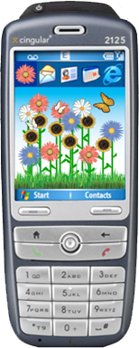








EG: ubifit
fitness monitoring application
automatically senses activity
at-a-glance goal information
3-month study; those with ambient display outperformed those without
strength
cardio
flexibility
walk
week’s goal met
recent goal met
Consolvo, S., et al. "Flowers or a Robot Army? Encouraging Awareness & Activity with Personal, Mobile Displays" UbiComp 2008, COEX, Seoul, South Korea, September 21-24, 2008.
Notes:
The most important part was the condition that people had the personal ambient display. Did everyone set a goal across conditions?

Slide 5
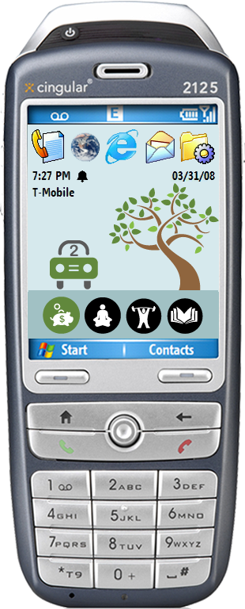
EG: ubigreen
transportation display
design influences
feedback literature
ubifit
two formative studies
an online survey
an in situ (ESM) study
Notes:
Our work focuses on using technology to encourage green transportation habits among individuals who have a preexisting interest in taking action to lessen their impact on the environment. We built the UbiGreen Transportation Display (Figure 1), which supports awareness of personal transportation activities, reminds users of additional reasons for being green (e.g., financial savings), and reinforces their commitment to ecofriendly behavior.
The design of the UbiGreen Transportation Display was influenced by three major factors: two formative studies that we conducted to better understand current transportation behaviors: an online survey and an experience sampling (ESM) study and Consolvo et al.

Slide 6
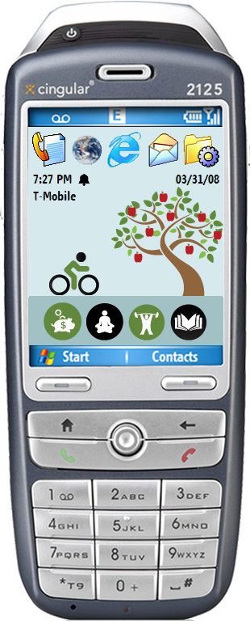
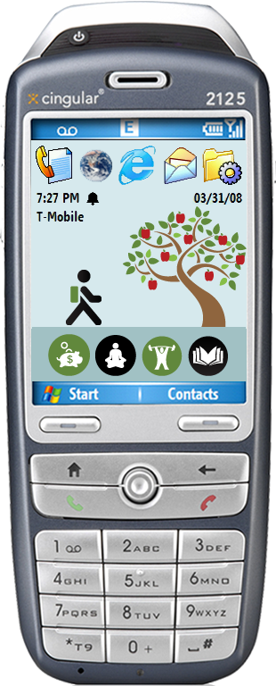
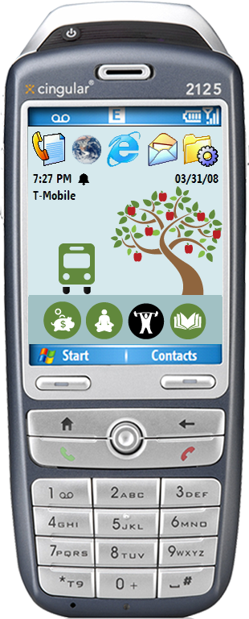
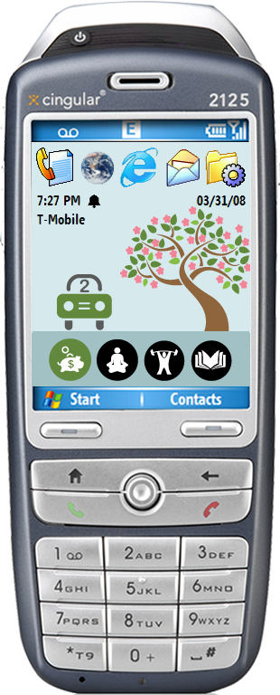
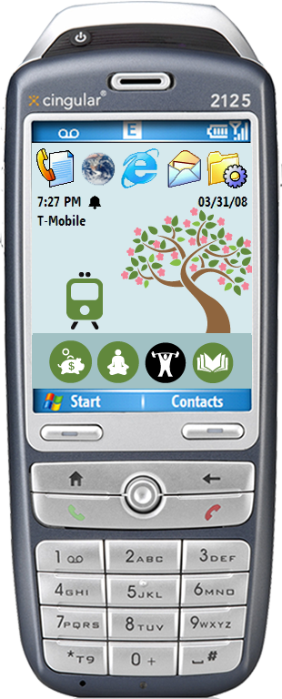
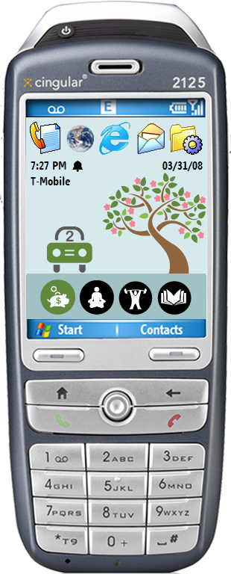
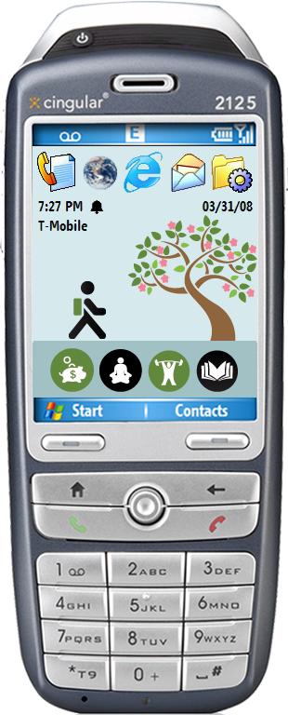
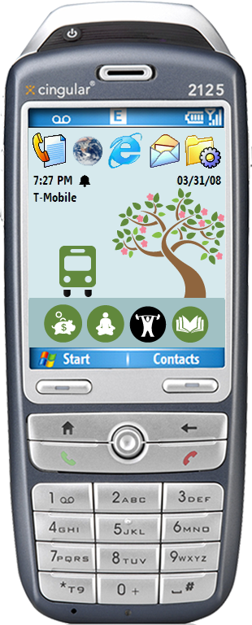



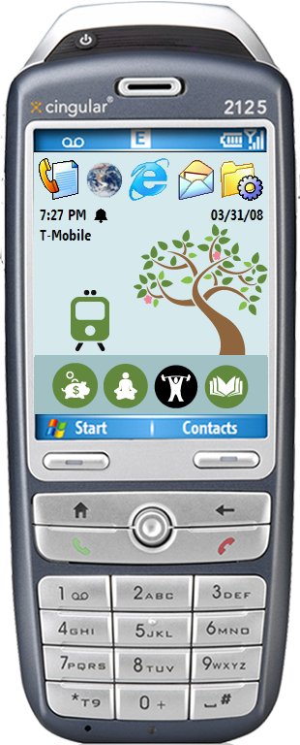
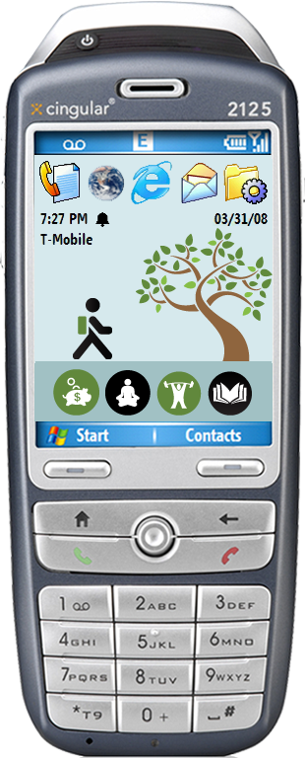
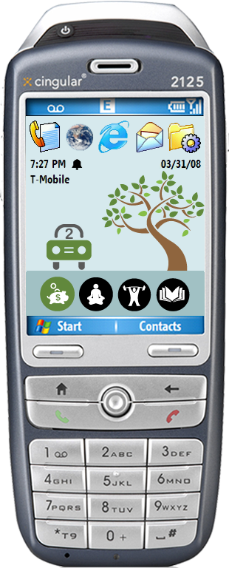
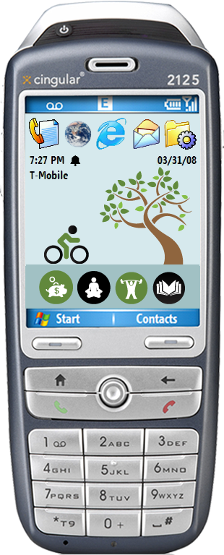

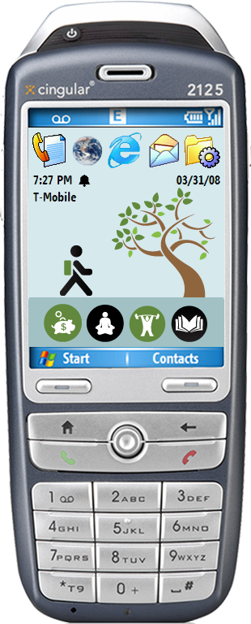
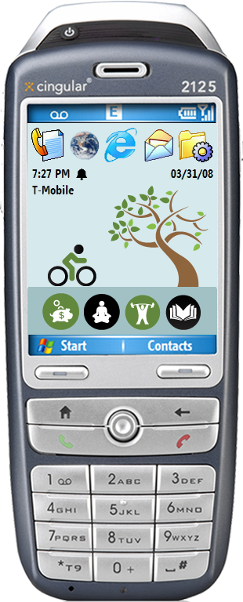
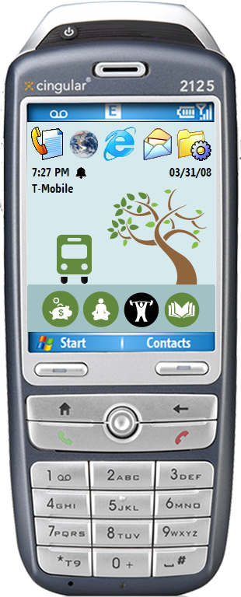

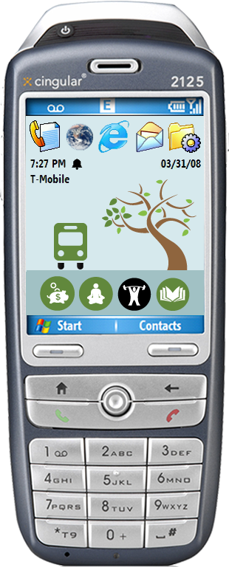

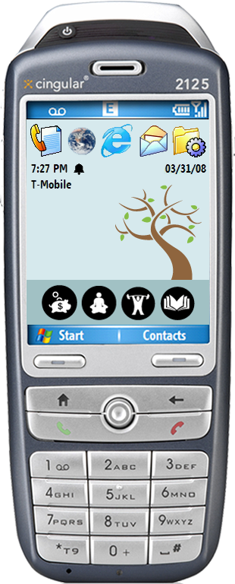
everything resets on sunday
Notes:
Maybe move this before going into interface details

Slide 7
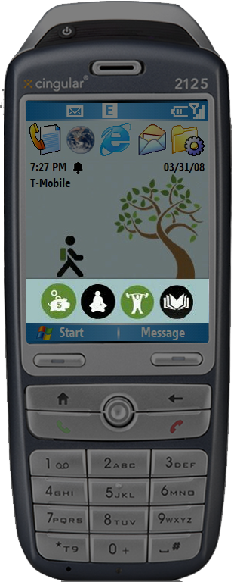
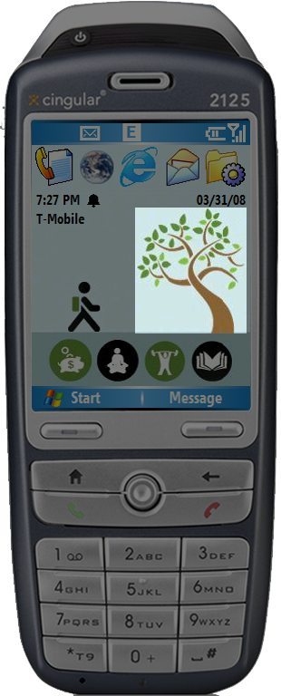
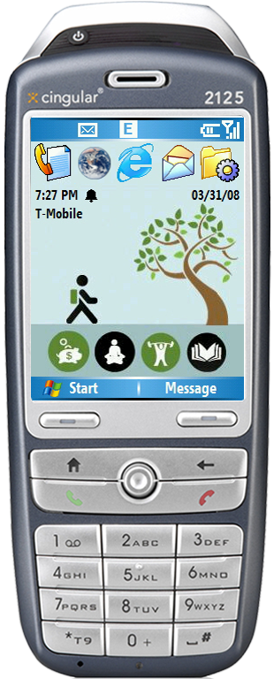
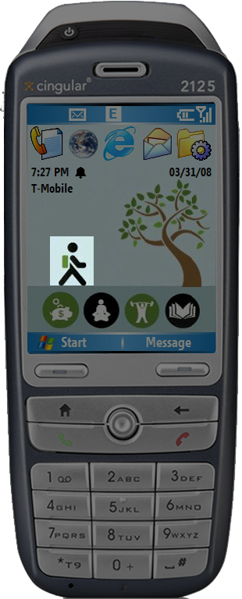
Phone
Background
(Wallpaper)
Current Activity
Evolving Image
Values Icon Bar

Slide 8


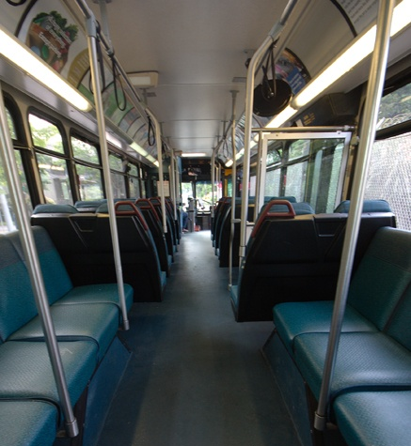
values icon bar
Money savings
Money savings
Relaxation
Relaxation
Exercise
Do other things
Do other things

Slide 9
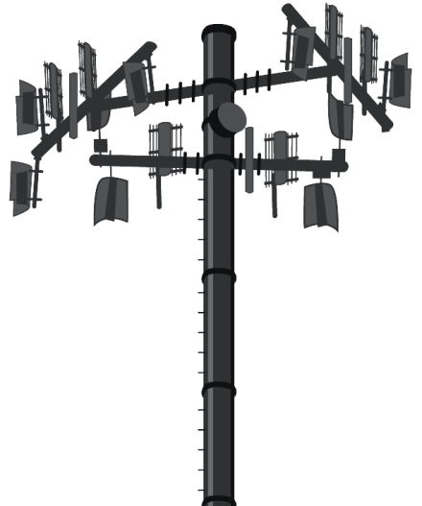
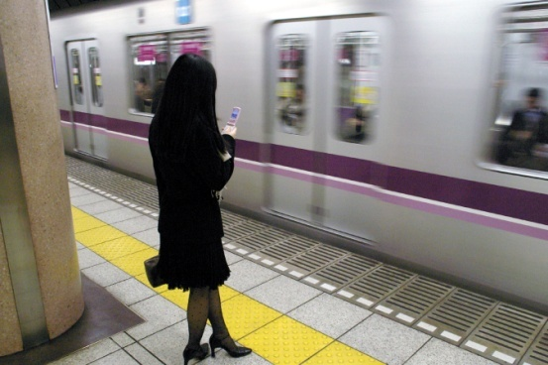
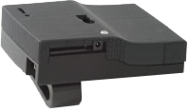

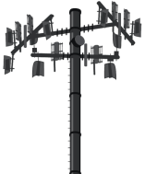


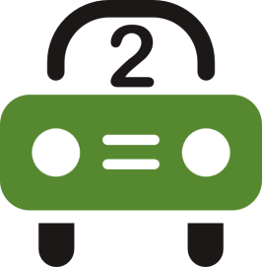



three data sources
1
2
3
msp
cell towers
user
Drive Alone
Walk
Bike
Train
Carpool
Bus
minimum activity duration: 7 minutes

Slide 10
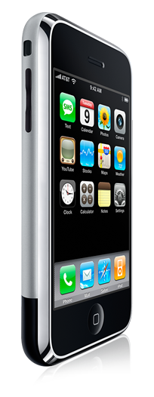
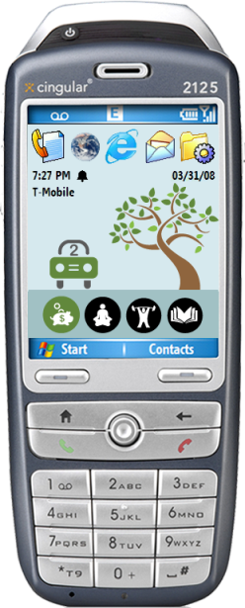
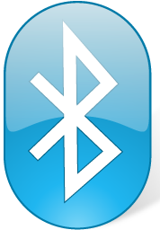
raw sensor data to transit activity
mean, median, range, etc.
measure of confidence for particular activities
collect raw sensor readings
calculate features
produce margins
generated at varying rates
generated at ¼ second intervals
smooth margins into meaningful actions
Send margins to phone via bluetooth
smoothing is defined by the application, not the MSP
Saponas, T., Lester, J., Froehlich, J, Fogarty, J., Landay, J. 2008. iLearn on the iPhone: Real-Time Human Activity Classification on Commodity Mobile Phones. University of Washington CSE Tech Report UW-CSE-08-04-02.

Slide 11
three data sources
1
2
3
msp
cell towers
user
Drive Alone
Walk
Bike
Train
Carpool
Bus
minimum activity duration: 7 minutes

Slide 12
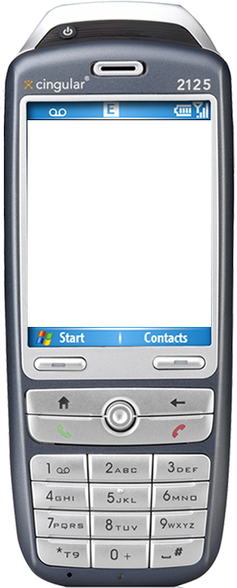
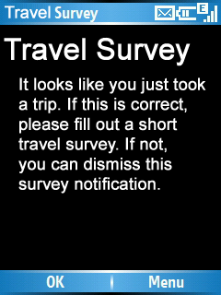
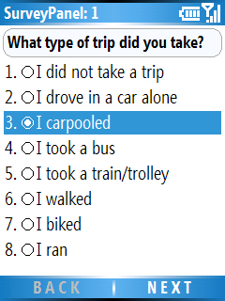
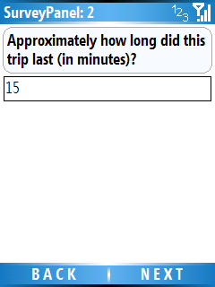
Notes:
This is not how we envision the actual system; we are currently working on inferring these automatically.

Slide 13
three data sources
1
2
3
msp
cell towers
user
Drive Alone
Walk
Bike
Train
Carpool
Bus
minimum activity duration: 7 minutes

Slide 14
3-week field study
obtain preliminary feedback on prototype
visual design
engagement
potential for social use
ideas for future designs
evaluate sensing algorithms for recording transit activities
the eventual goal is to reduce/eliminate the need for explicit user feedback
Notes:
!!!!Need a picture!!!

Slide 15
mobile data collected
8.4 million logged sensor events
1,129 travel events (72% green)
4.2 travel events per participant/day
average trip length: 18 minutes
23 minutes for green trips
Notes:
Need picture!

Slide 16
observed transit
Notes:
Walking was the number one form of transit, accounting for 31% of all observed transit events
Driving alone, however, was the second most popular form of travel accounting for 22% of observed transit events
Followed by carpooling at 19%

Slide 17
source of data
24.2%
35.3%
40.6%

Slide 18



AWARE framework
Sense, store & share
Reuse, interact & understand
Developers
AWARE
Context
Researchers
Abstract & Simplify

Slide 19
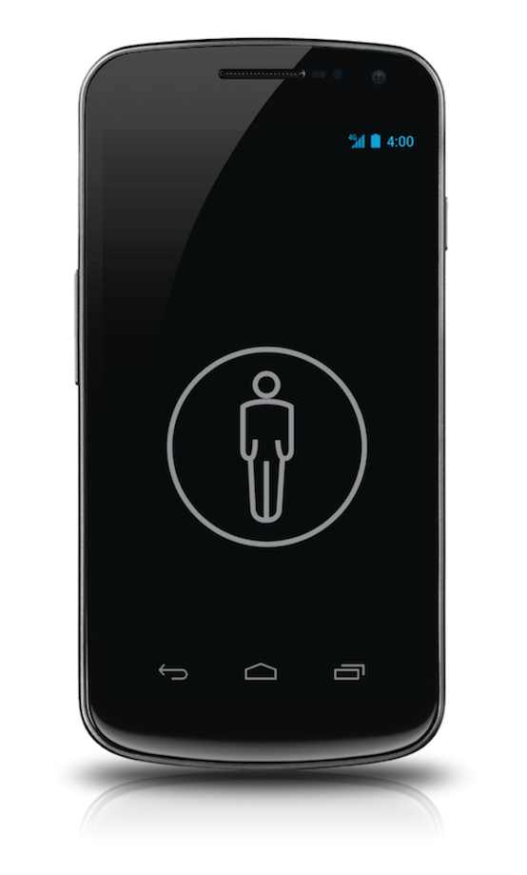
Plugins help:
Diet tracking
application
Accelerometer
Step counter
(plugin)
Activity Recognition
(plugin)
Calorie counter
(plugin)
noisy data
Mobility
application
REUSABILITY is the key here!

Slide 20
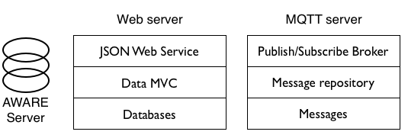
AWARE Server
Tables we will use are documented in the byte

Slide 21
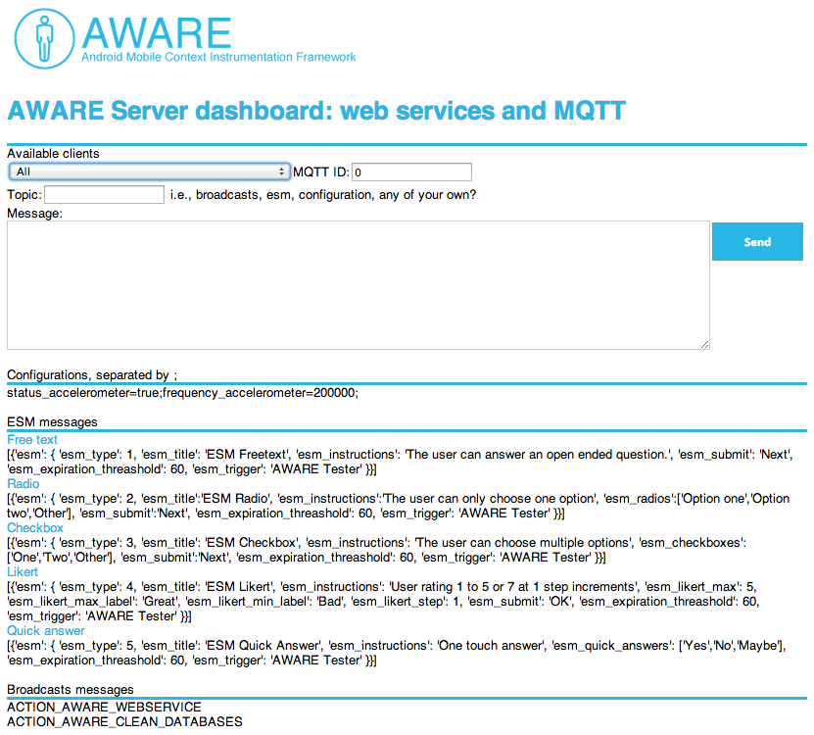
AWARE Server dashboard

Slide 22
Installing AWARE Client
Just download the APK provided on Blackboard
Don’t worry about the AWARE Server, we have one for you to use!
However: You have to create your byte AND send me its name to access the data. Please do this BY 3pm Friday. I will be offline after that through Tuesday!

Slide 23
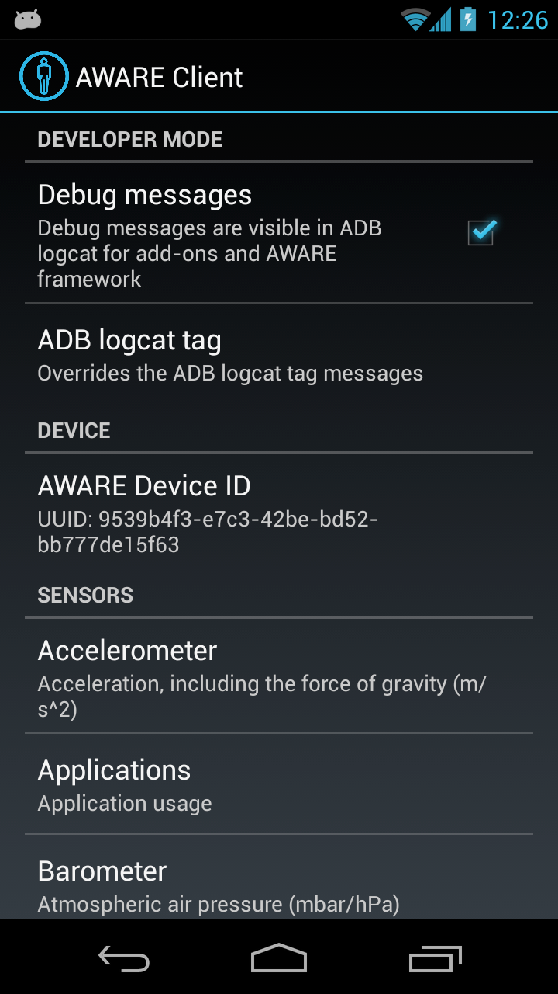
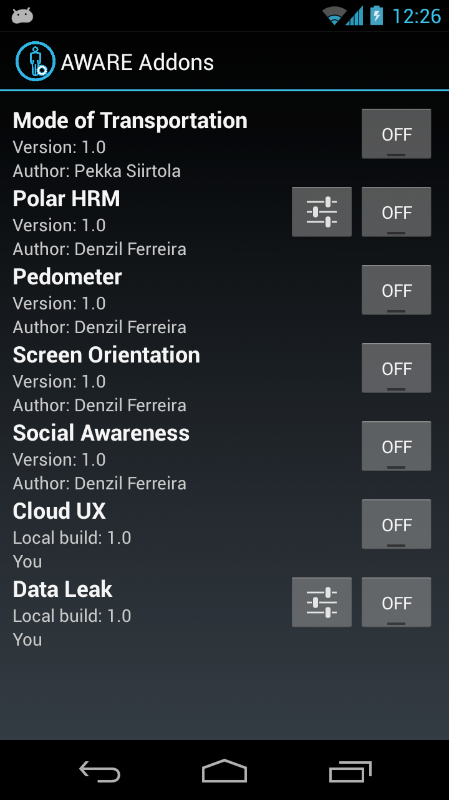
AWARE Client

Slide 24
Accessing your data
I have not configured the database for ‘local’ access – you will have to work only on the Google Appspot server
You will need to use the MySQLdb library provided by Google (update app.yaml & main.py to reference this)
You will need to give me your instantiated app’s name by 3pm Friday.

Slide 25
Accessing MySQL
db = MySQLdb.connect(unix_socket='/cloudsql/' + _INSTANCE_NAME, db=_DB, user='root')
cursor = db.cursor()
Helper function – prints result to log
self.make_and_print_query(cursor, 'SHOW TABLES', 'Show the names of all tables')
Helper function – returns result as list
rows = self.make_query(cursor, query)

Slide 26
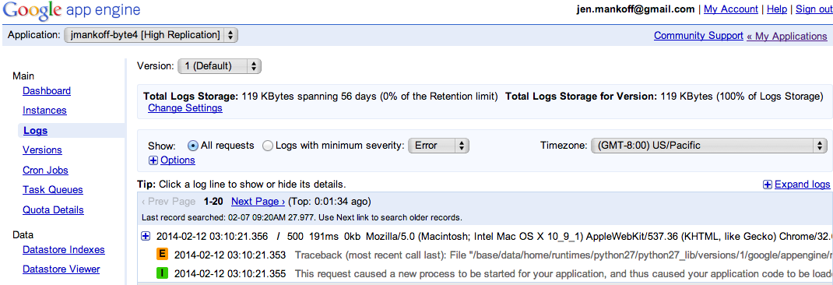
Debugging this assignment
Server side debugging is a bit of a pain
Google helps though – provides access to logs

Slide 27
More Debugging
My helper function prints recent SQL commands to log and catches SQL query errors
You may also see errors show up in the [yourname]-byte4 browser window

Slide 28
What do can need to do with mobile data?
Cleaning: can you tell when the phone is off? (not a focus of this byte)
Organizing: identifying common locations (what the byte walks you through)
Associating: connecting activities to other context (we explore location + activity, homework is to explore time + activity)

Slide 29
Hand In Expectations
Improve the location binning by picking a better epsilon.
Explore about relationship between time and activity (your main job on this assignment)
Display the results (more nicely than I do!)

